Slide 1

E-wallet Web Application
Graphical User Interfaces Project
Davide Scaccia, Danilo Spera, Arcangelo Mauro, Giovanni Romano, Arthur Phommachanh

Slide 2

Introduction:
Our project is CashHive, an e-wallet application with the following features:
Login - Register
Deposit
Withdraw
Budget
Transaction History
Send/Receive Money
Request Money
Piggy Bank
Friend List

Slide 3



Overview Of Technologies:
Frontend:
PrimeFaces
Backend:
Jakarta EE
PostgreSQL

Slide 4
Team Members’ Work:
Implementation Details:
Code Contributions:
Davide Scaccia: Entities/, AuthService, EmailService, RateLimiterService, RegistrationResult SecurityFilter, SessionTimeoutConfig, UserBean, VerificationBean, DatabaseMigration, DatabasePrint.
Arcangelo Mauro: WithdrawalBean, SendBean
Danilo Spera: RequestBean, DepositBean, BankApiSimulator, RestApplication, SimulatedPayment, PaymentInfo, PaymentService, bank-simulator Application.
Giovanni Romano: TransactionBean, BudgetBean
Arthur Phommachanh: PiggyBank, FriendList, store-simulator Application
Tasks handled together: pom.xml, web.xml, persistence.xml, Database Schema

Slide 5
Screenshots of Application

Slide 6
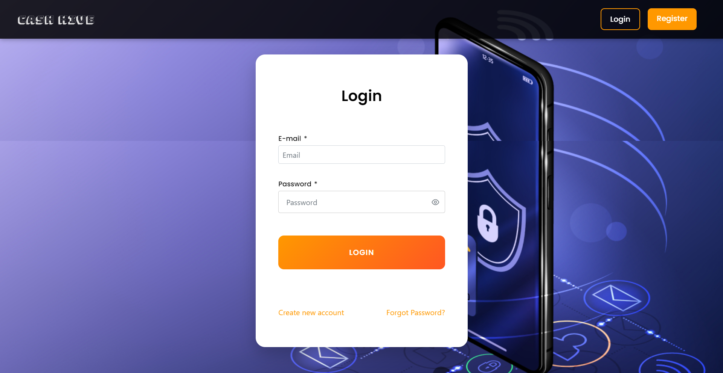
Login

Slide 7
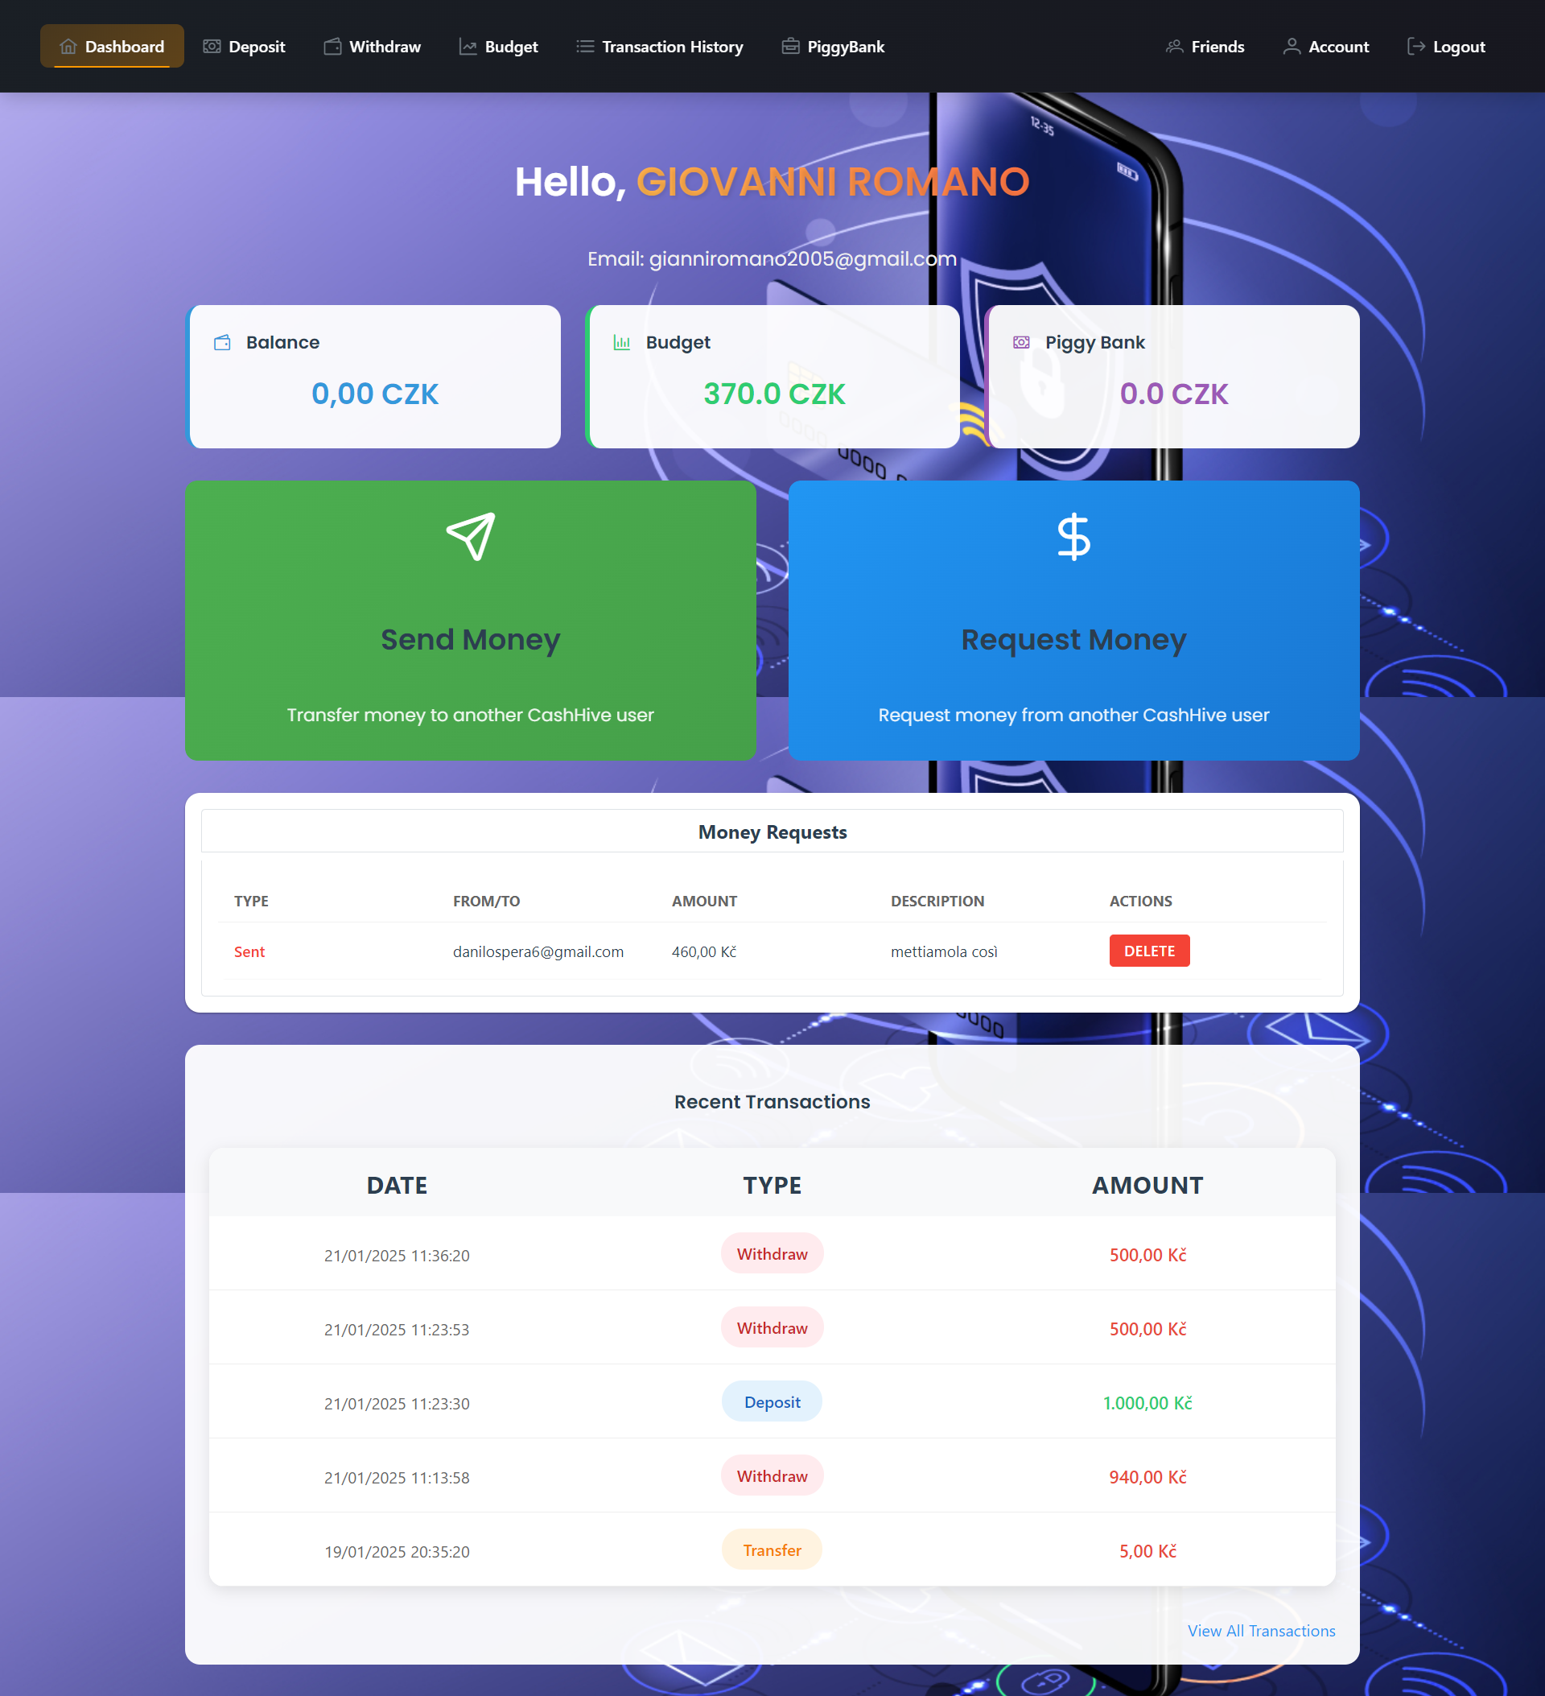
Dashboard

Slide 8
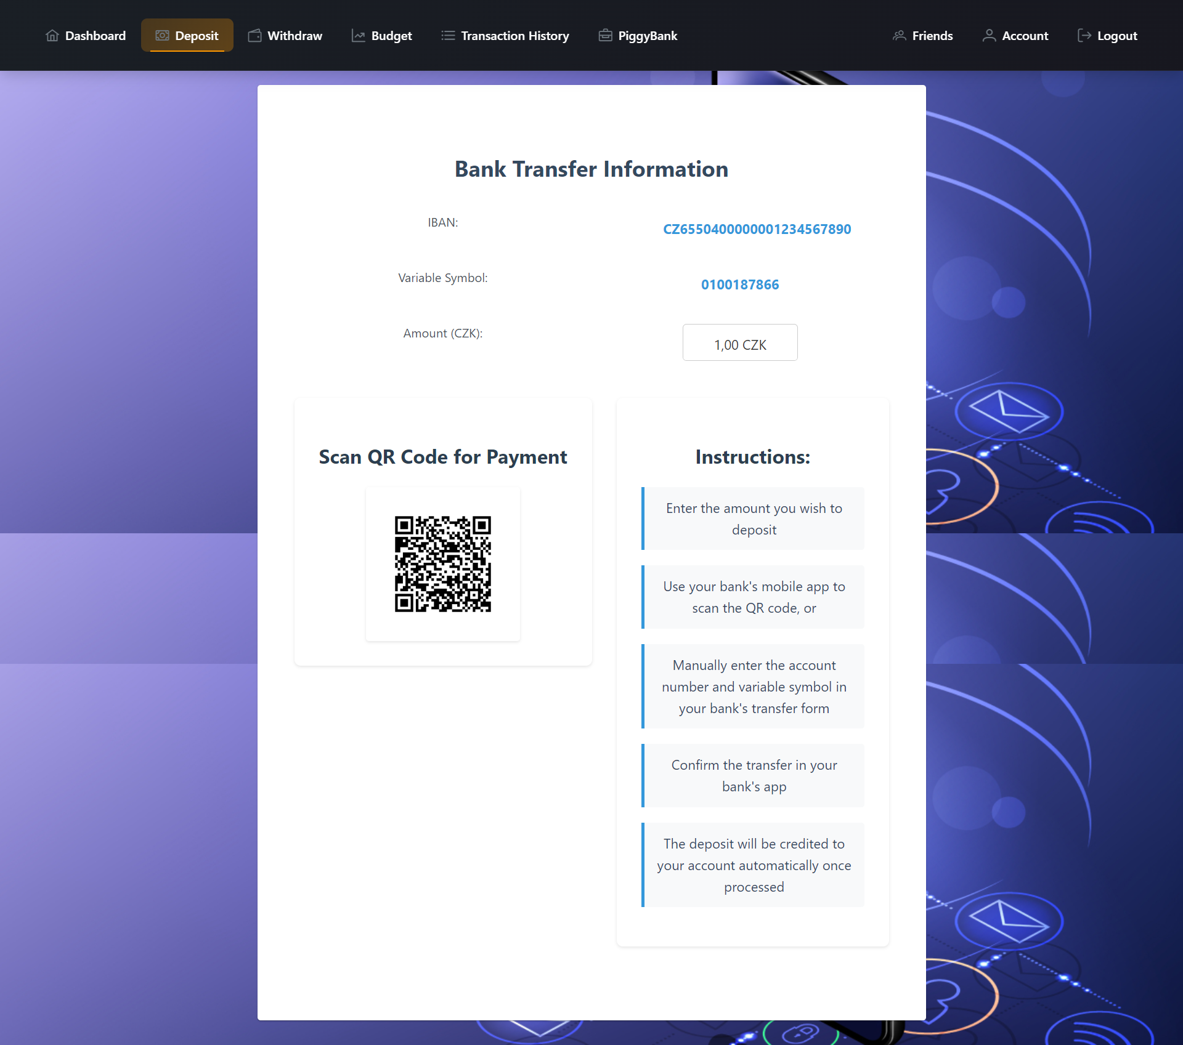
Deposit

Slide 9
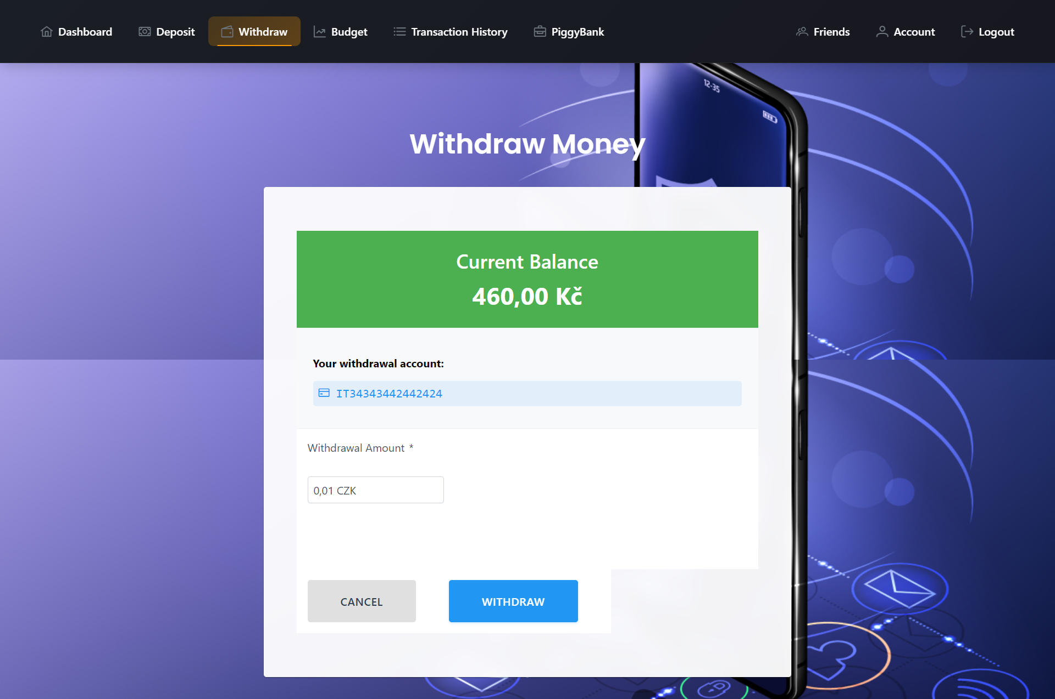
Withdraw

Slide 10
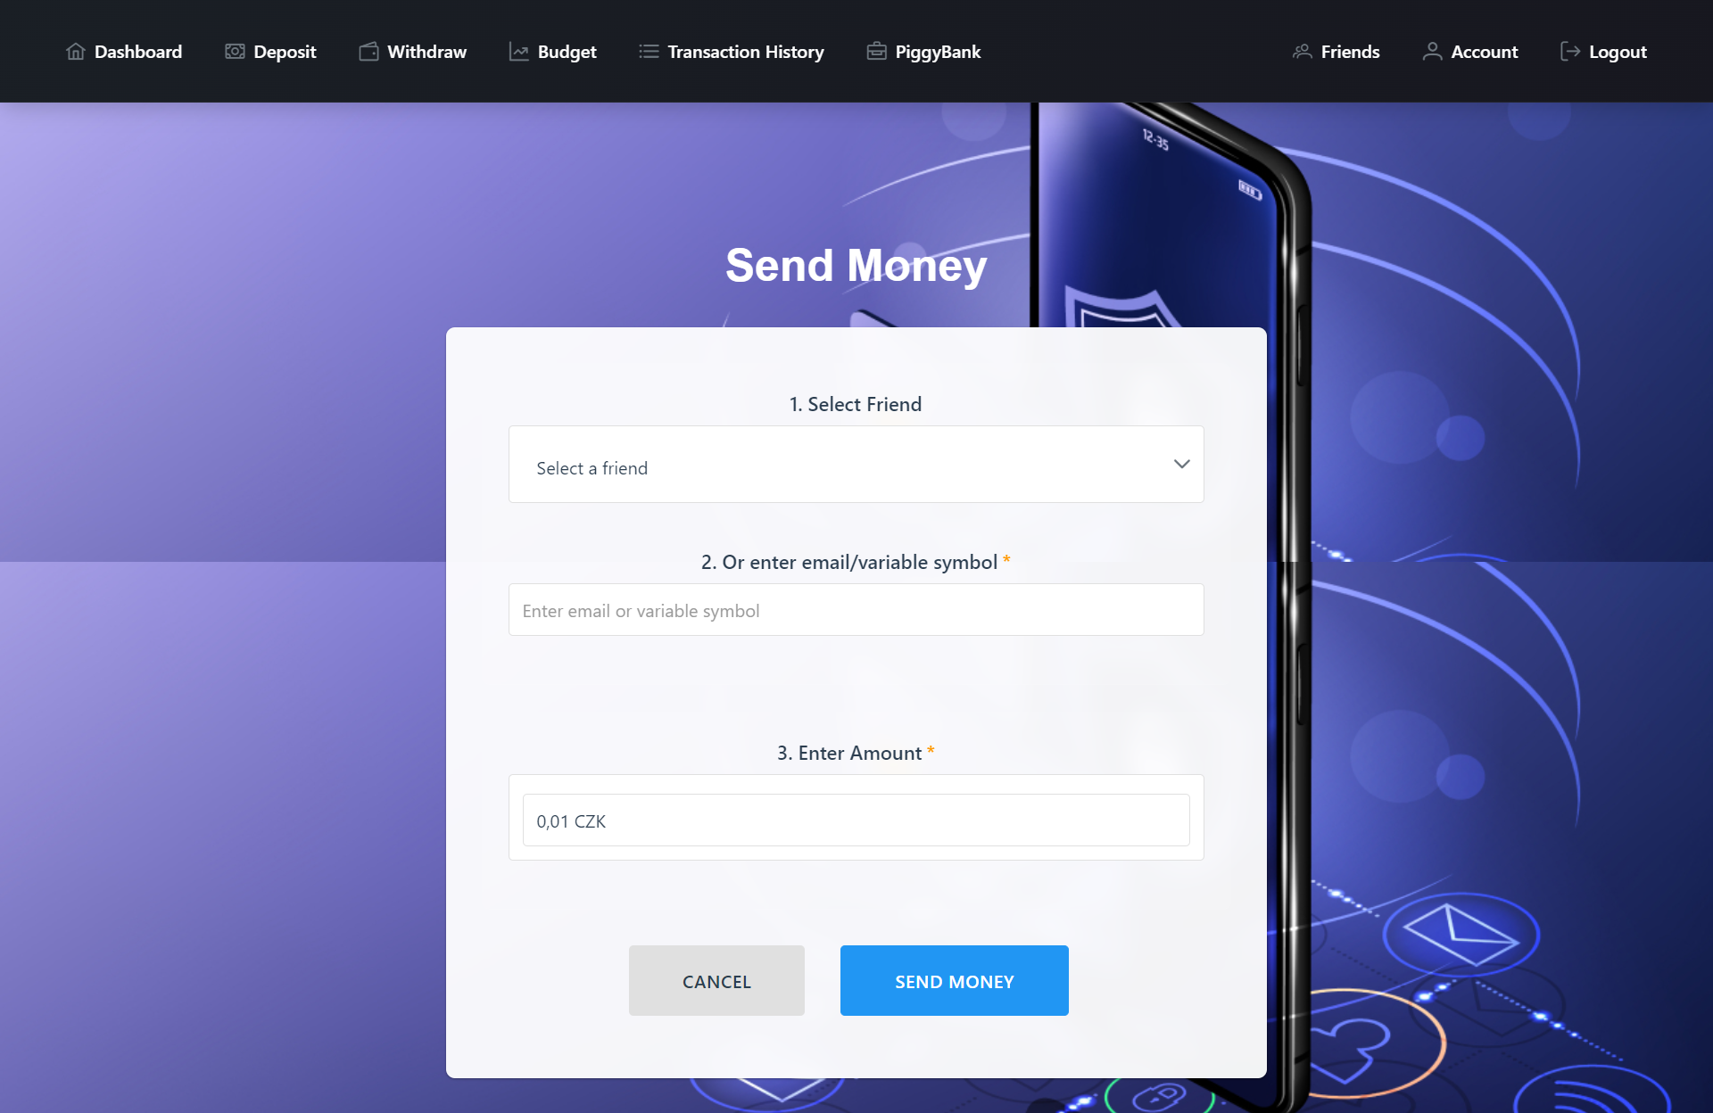
Send

Slide 11
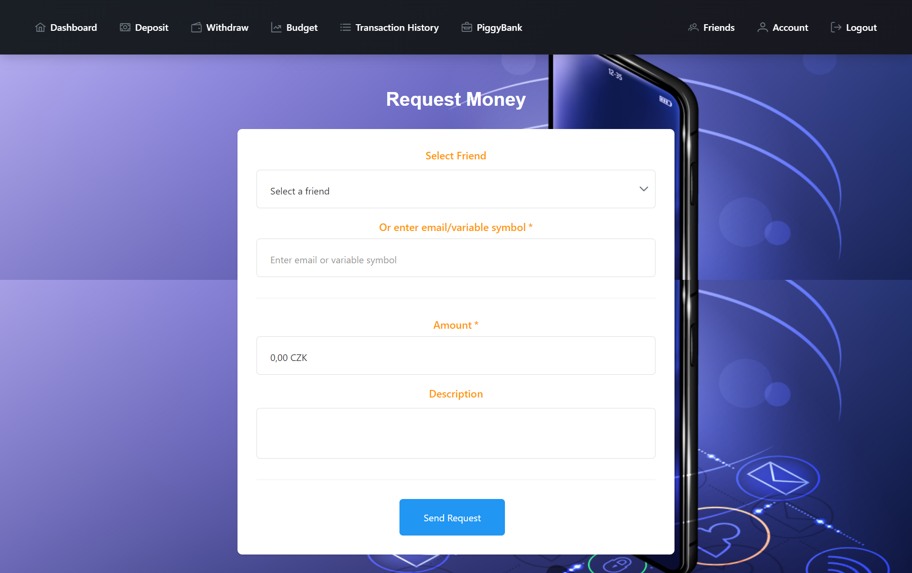
Request

Slide 12
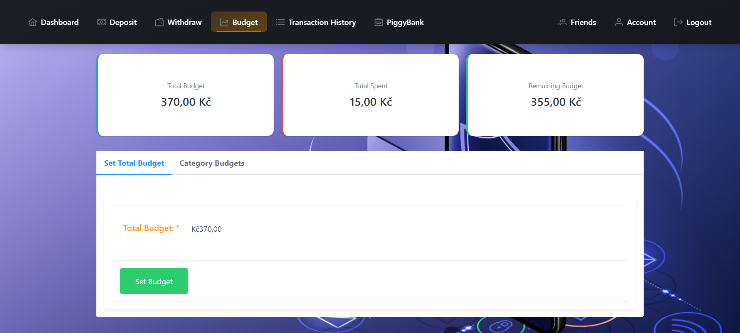
Budget

Slide 13
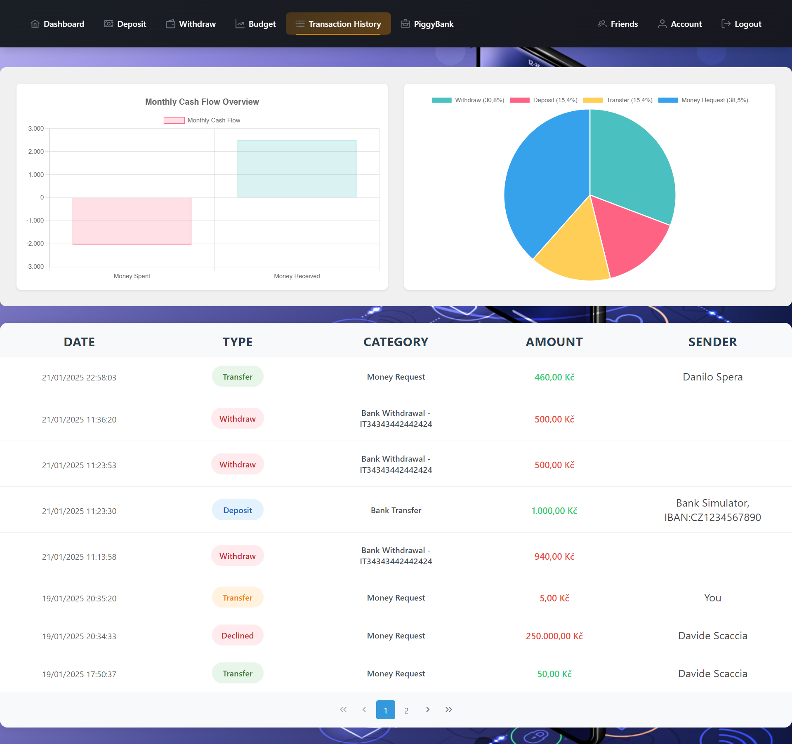
Transactions

Slide 14
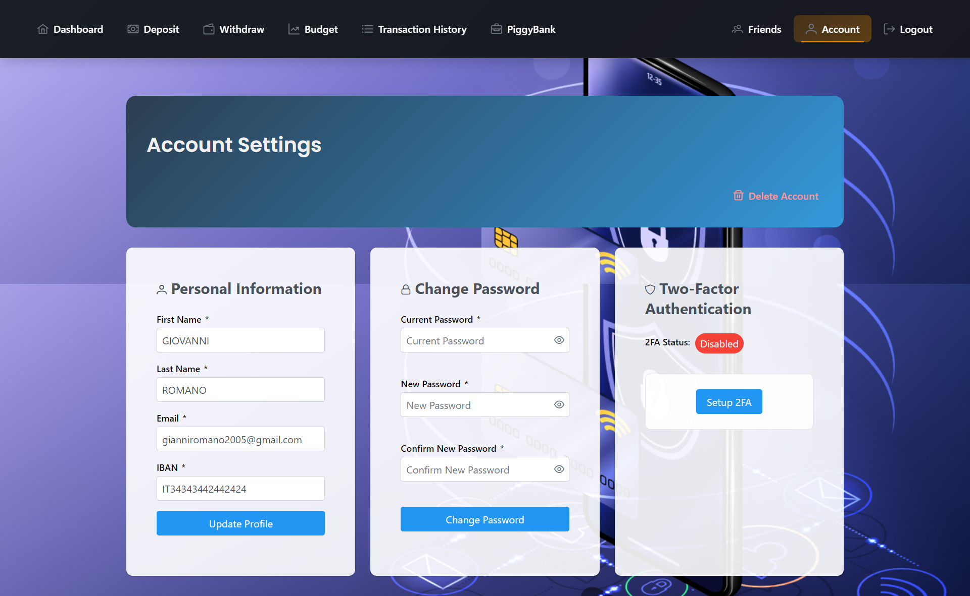
Account

Slide 15
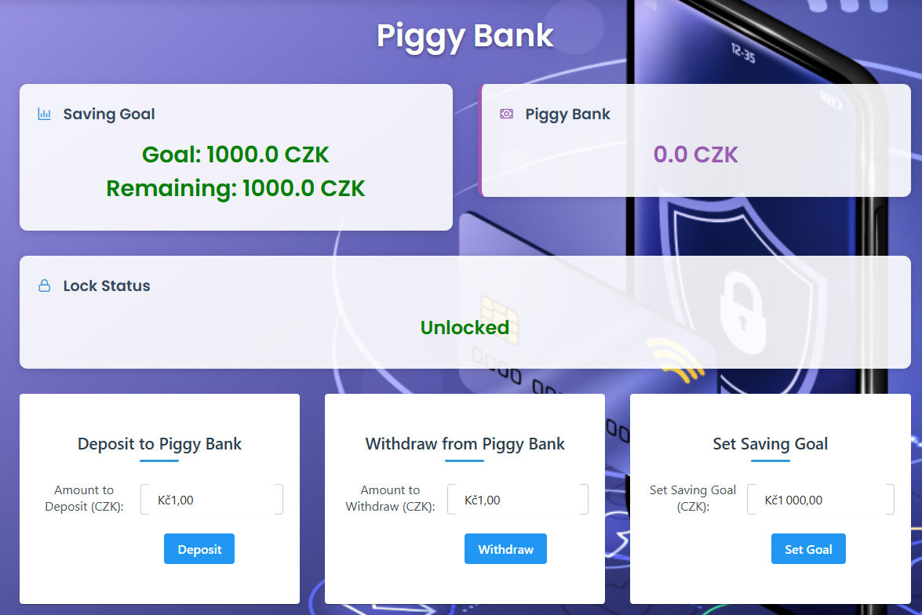
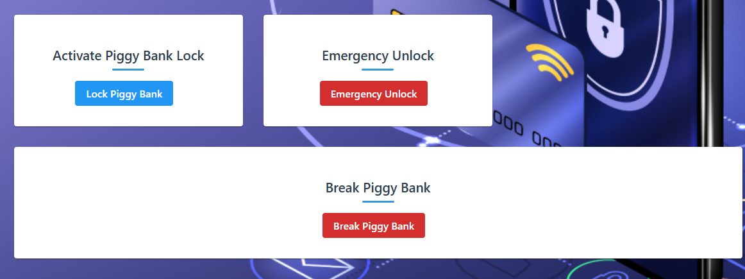
PiggyBank

Slide 16
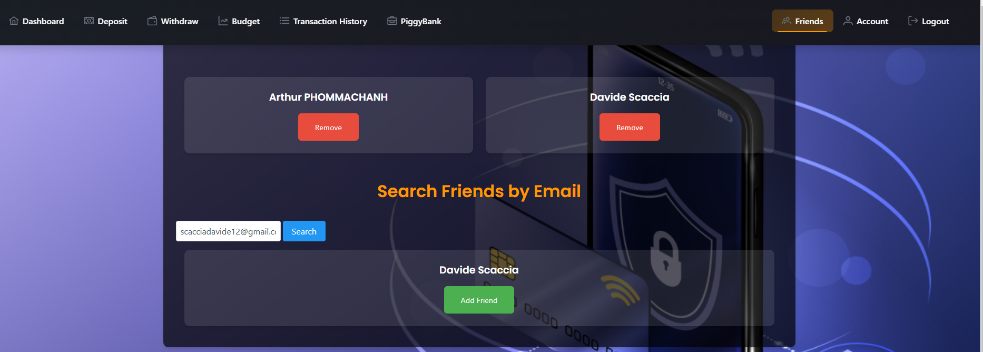
FriendList

Slide 17
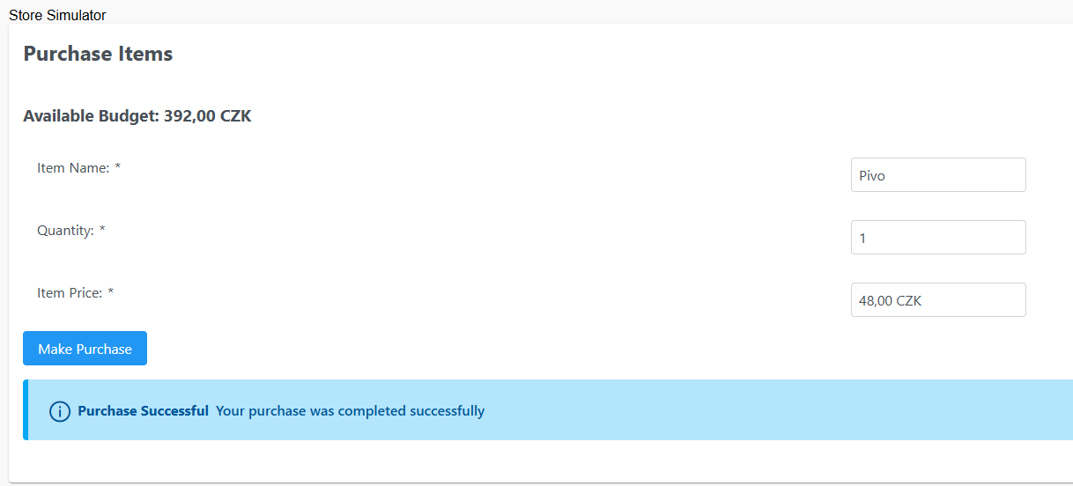
Store Simulator

Slide 18
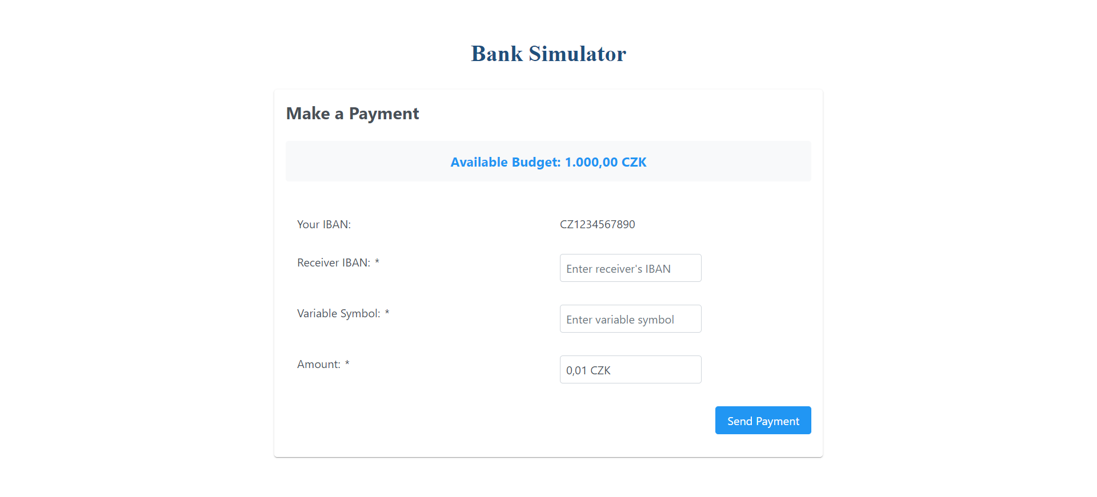
Bank Simulator

